Slide 1

What to Expect Before you Get the Job: A Guide to the Academic Librarianship Hiring Process
Wednesday, March 11th, 2026
6-7pm

Slide 2
Meet Our Panelists!

Slide 3
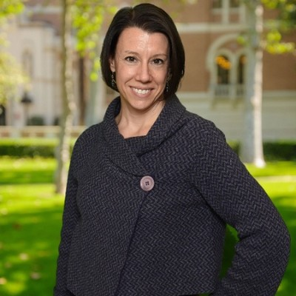
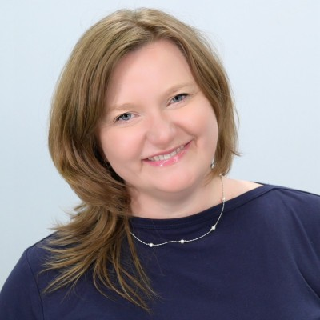
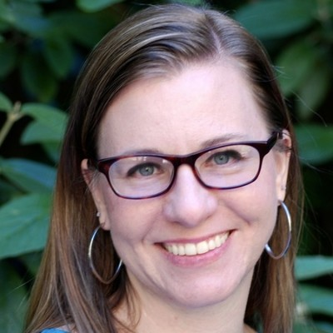
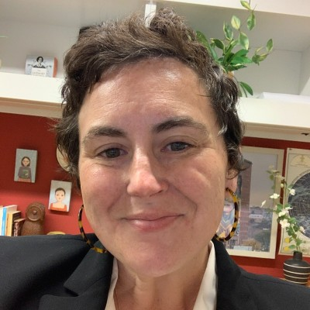
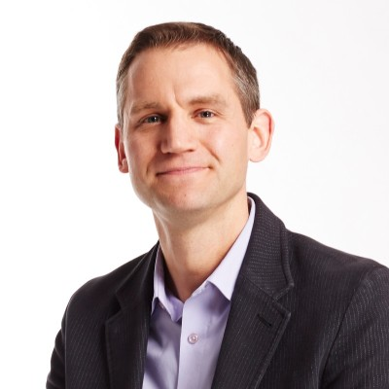
Lisa Thornton
Seton Hall University
Ewa Dziedzic-Elliot
The College of New Jersey
Kelee Pacion
Princeton University
Jen Hunter
Princeton University
John T. Oliver
The College of New Jersey

Slide 4
Questions?
Unmute or ask in the chat!

Slide 5
SCARLA Resources :)
Feminism in Academic Librarianship
Tuesday, April 22nd 6-7pm
Info & registration: https://scarla.rutgers.edu/events/
CritLib
Date: March/April
Topic TBD
Join SCARLA’s listserv →
Send an email with “subscribe” in subject line to
comminfo_scarla-join@email.rutgers.edu

