Slide 1
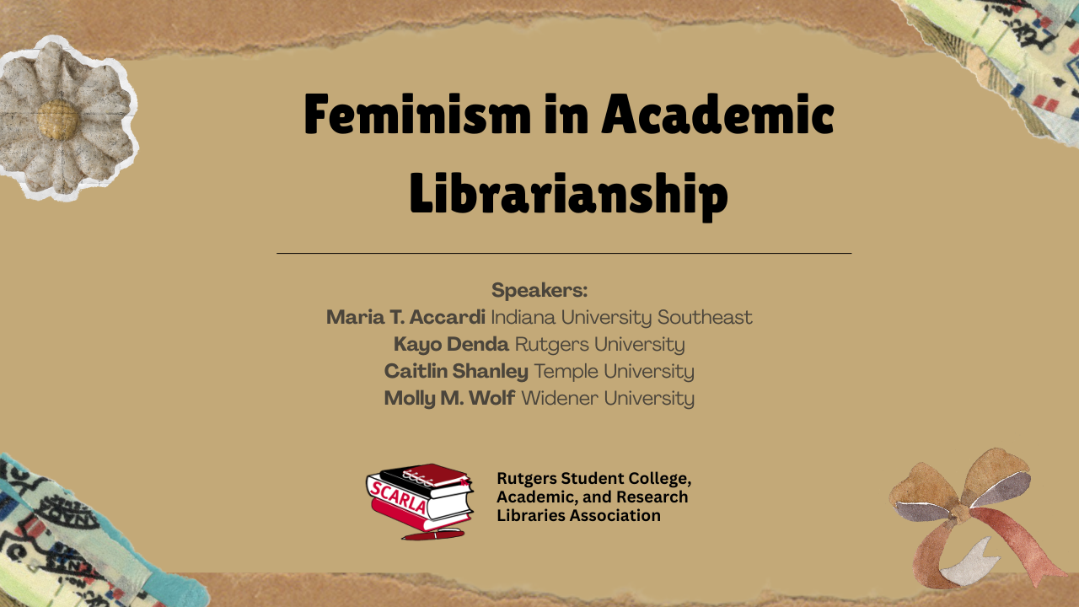

Slide 2
Maria T. Accardi
Maria T. Accardi is the author of Feminist Pedagogy for Library Instruction (2013). She is also co-editor of Critical Library Instruction: Theories and Methods (2010), and editor of The Feminist Reference Desk: Concepts, Critiques, and Conversations (2017). Maria is the Coordinator of Instruction and Assessment at Indiana University Southeast, a regional campus in the IU system, located in New Albany, Indiana. Maria holds a BA in English from Northern Kentucky University, an MA in English from the University of Louisville, and an MLIS from the University of Pittsburgh. Her primary research and writing interests address the intersections of information literacy, reference work, social justice, and feminist and other critical pedagogies. She lives in Louisville, Kentucky, with her wife and super senior cat.

Slide 3
Kayo Denda
Kayo Denda is the Head of the Margery Somers Foster Center and Librarian for Women’s Gender and Sexuality Studies at Rutgers New Brunswick Libraries. She is the liaison librarian to the Women’s and Gender Studies Department, Institute for Women’s Leadership, Institute for Research on Women, and Douglass Residential College. She had worked over the years identifying and providing digital access to unique collections, such as the award-winning Center for Women’s Global Leadership Poster collection and the Women, Education and Leadership at Rutgers interview portal. Her publications include the co-authored monograph Douglass Century: Transformation of the Women’s College at Rutgers University. Denda is the recipient of the Smithsonian Fellowship in Museum Practice, the Career Achievement and the Significant Achievement Awards in Women’s Studies Librarianship from the ACRL, and the Douglass Medal from the Associate Alumnae of Douglass College. Raised and educated in Brazil, she has the MLS and MA degrees from Rutgers University.

Slide 4
Caitlin Shanley
Caitlin Shanley (she/her) is the Coordinator of Learning and Student Success and the liaison librarian for Gender, Sexuality, and Women’s Studies at Temple University. She holds a BA in Literature and Women’s Studies from the University of North Carolina at Asheville, and an MSLS from the University of North Carolina at Chapel Hill. Her library work centers intersectional feminist frameworks for information literacy, and the role of libraries in building community on campus. She also draws inspiration from her work as Secretary of TAUP, the union of faculty, librarians, and academic professionals at Temple. Outside of work, she spends time sewing her own clothes, hanging out with her two cats, and finding Philadelphia’s best sandwiches.

Slide 5
Molly M. Wolf
Molly Wolf is the Executive Director of the Wolfgram Memorial Library at Widener University and the Founder and Curator of the Sexuality Archives of Widener University. As the sexuality archivist, Molly is passionate about preserving the ideas and artifacts of the sexuality field and works tirelessly to get them into the hands of students and researchers alike. Molly is uniquely qualified for her position by holding both a Master's of Science in Library and Information Science and a Master's of Education in Human Sexuality Education. She lives with her husband, son, and dog in the suburbs of Philadelphia.

Slide 6
Thank you for coming!
SCARLA Website
scarla.rutgers.edu
SCARLA ListServ Sign-Up Info
scarla.rutgers.edu/mailing-list
Contact SCARLA
rutgers.scarla@gmail.com

